Slide 1
PROJECT PHASE-3 PRESENTATION
Project Title: Disease Prediction Using Machine Learning
Submitted By: Submitted To Guide:-
Harsh Dhonchak(190184065) Dr. Aditya Dev Mishra
Harsh Kumar(190184062) Assistant Professor
Kartikey Dixit(190184069) School Of Computing
Kanak Agrawal(190184067)
B.Tech-CSE-AI ans DS-Section-B

Slide 2
Contents
Project overview
Project Objectives
System description
Implementation details
Methodology
State Chart Diagram
Data Flow Diagram
Work load
Screenshots

Slide 3

Project overview
→ Disease prediction using machine learning is a system that predicts diseases based on information provided by users. It also predicts the patient's or user's illness based on information or symptoms entered into the system and provides accurate results based on this information , If the patient is not very serious and the user only wants to know the type of disease, that they have already experienced .
→ It is a system that provides users with precautionary tips and measures to maintain the user's health and provides a way to use this prediction to find diseases .
→ So just by entering the symptoms and all other useful information, the user can know the disease he is suffering from, and *the health industry can also benefit by asking the system about the user's symptoms and logging into the system.*

Slide 4


Project Objective
1. The overall objective of this project is to write a program that will predict the disease based on information or symptoms entered in the system .
2. Today, the health industry plays an important role in curing the diseases of patients, so this is also some kind of help that the health industry tells users, and it is also helpful to go to the hospital or any other clinic when the user does not want to.
3. According to research, 40% of people ignore common diseases and lead to harmful diseases later on. The main reason for developing this project is that users can sit at your convenience and check your health. So, this application will be useful for a large population

Slide 5
PROJECT FEATURES:
Using datasets, this project will forecast the diseases of patients based on their symptoms and other basic information.
This is based on the hospitals' past datasets, therefore after comparing, it can produce almost exact findings.
It can anticipate the patient's disease, solve various difficulties, and prevent many aspects with the use of Disease prediction.
It secures the system, ensuring that no one can access it or make modifications to it. The user must select symptoms from a drop-down menu, and the illness is predicted using algorithms . The user must choose all symptoms in order to get accurate findings.
Here, we can swiftly prepare data and transform it into an algorithm, minimising the overall workload of the project.
The user first registers and than uses the login id and password to enter into the system and further use the applications features.
After which user needs to provide some basic details of signup and then the details of user are saved in system

Slide 6
LITERATURE SURVEY
MACHINE LEARNING :
The study of computer systems that can improve themselves automatically based on experience and data is known as machine learning (ML).
Every machine learning is not statistical learning, whereas it is related to some mathematical statistics for making predictions with computers. Mathematical optimization research provides tools, theory, and application domains to the subject of machine learning.
Machine learning algorithms can do tasks that aren't explicitly encoded into them. It comprises computers learning from data in order to complete specified jobs.
It is feasible to design algorithms that teach the machine on how to perform all steps necessary to solve the problem at hand for basic jobs entrusted to computers; no learning is required on the computer's part.

Slide 7
PYTHON :
Python is a high-level interpreted programming language which is used for various of purposes. Functional programming, aspect-oriented programming (including metaprogramming and metaobjects), object-oriented programming, and structured programming are all possible with its capabilities.
Python's developers strive to avoid premature optimization by rejecting non-critical Python changes that may provide minor performance gains at the expense of clarity.
A Python programmer can use PyPy, a just-in-time compiler, or relocate time-sensitive routines to C extension modules when performance is necessary. Python’s developers made it a top priority to make the language fun to use.

Slide 8
NODE JS :
Node.js is an open-source programming language that runs on several platforms. Back-end. Runtime for JavaScript.
Despite the fact that .js is the standard filename suffix for JavaScript code, "Node.js" refers to the entire product rather than a single file. Asynchronous I/O is possible because to Node.js' event-driven design.
The Node.js split development project was headed by the Node.js Foundation, which has now combined with the JS Foundation to become the Open JS Foundation, which is funded under the Linux Foundation's Collaborative Projects programme.
Node.js only supports JavaScript as a native language, however there are several compile-to-JS languages available. Node.js apps may now be created in a variety of languages, including Coffee Script, Dart, TypeScript, Clojure Script, and others.

Slide 9
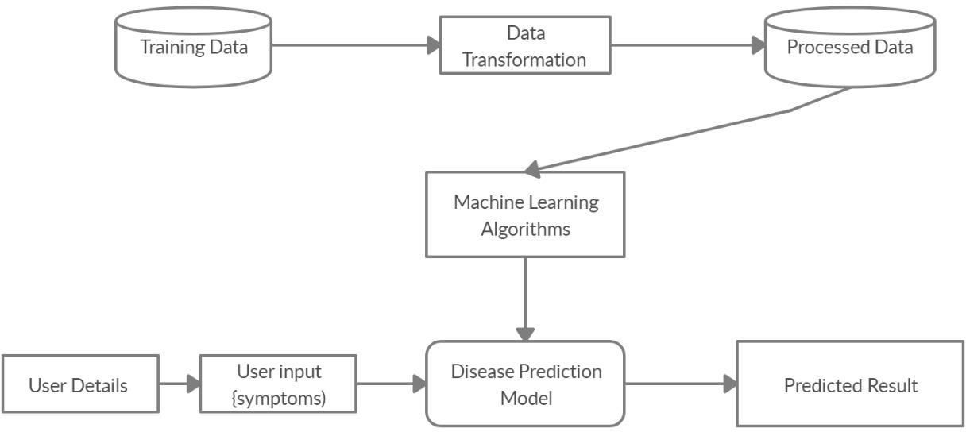
System description
Figure- Flow chart of system

Slide 10
System description
Once the user opens the system to login they need to register by clicking on register/signup button
After which the user needs to provide some basic details of signup and then the details of user are saved in the system.
Then user needs to login to have a checkup of his/her health.
When user tries to login if he provides wrong user name the system will provide a prompt message stating that the user is not found
And if user tries to enter the wrong password the system will prompt stating that password is in correct hence the user needs to enter the correct user id and password to get in to the system

Slide 11
System description
After user enters the system , user has to provide the symptoms which he/she is going through based on which we have several algorithms which predict the disease and also displays the percentage of accuracy
The user needs to enter all the columns of symptoms to get the accurate result.
Data collection and dataset preparation - This will involve collection of medical information from various sources like hospitals, then pre-processing is applied on dataset which will remove all the unnecessary data and extract important features from data.
Training and experimentation on datasets- The Disease Prediction model will be trained on the dataset of diseases to do the prediction accurately and produce Confusion matrix. In this project 3 different algorithms are used –
Decision Tree Algorithm
Random Forest Algorithm
Naïve Bayes Algorithm

Slide 12
Requirements
1. HARDWARE REQUIREMENTS
System : Pentium 4, Intel Core i3, i5, i7 and 2 GHz Minimum
RAM : 512Mb or above
Hard Disk : 10 GB or above
Input Device : Keyboard and Mouse
Output Device : Monitor or PC
2. SOFTWARE REQUIREMENTS
Operating System : Windows 7, 10 or Higher Versions
Platform : Jupiter Notebook
Front End. : React JS, HTML, CSS, JavaScript
Back End. : Python, JavaScript
Programming Language : Python, JavaScript

Slide 13
Methodology
The project is divided in three phases :
Phase-1
This phase will describe the problem statement and perform data collection , also the data will be pre-processed for training the model.
Phase-2
In this phase the processed data will be used to train the model and the results will be generated.
Phase-3
In this phase all the analysis part will be done and a comprehensive report will be developed including all three phases.

Slide 14
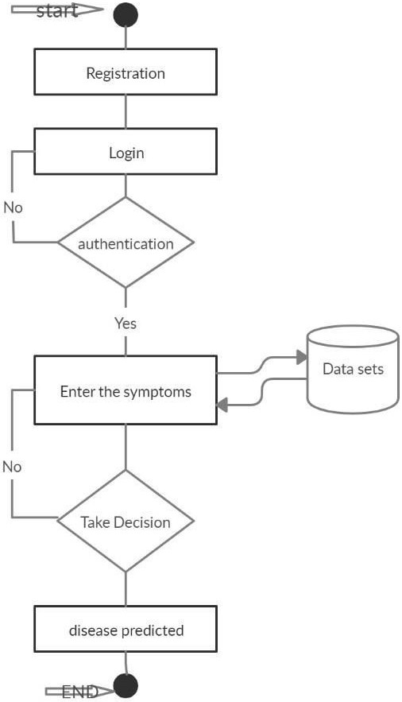
STATE CHART DIAGRAM

Slide 15
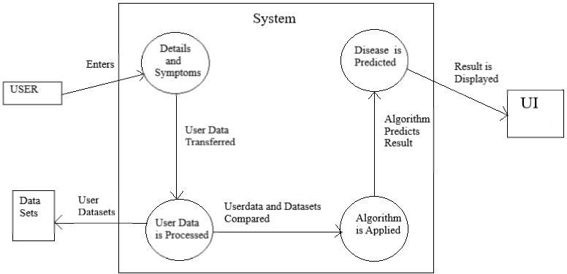
DATA FLOW DIAGRAM

Slide 16
Work load
The Front end of this project is developed in React and the Back-end in Python. So the work-load is divided as follows :
Harsh Dhoncak :- I will be pre-processing the data and will get the data ready for the model . I will also be helping in training the model.
Kartikey Dixit :- I will be building the front-end of the application in React.
Harsh Kumar :- I will also be developing the front-end and I will also help in connecting the back-end and front end.
Kanak Agrawal :- I will be checking the accuracy on the dataset and will train and validate the model.
We all will be helping each other in making presentations and report of the project.

Slide 17
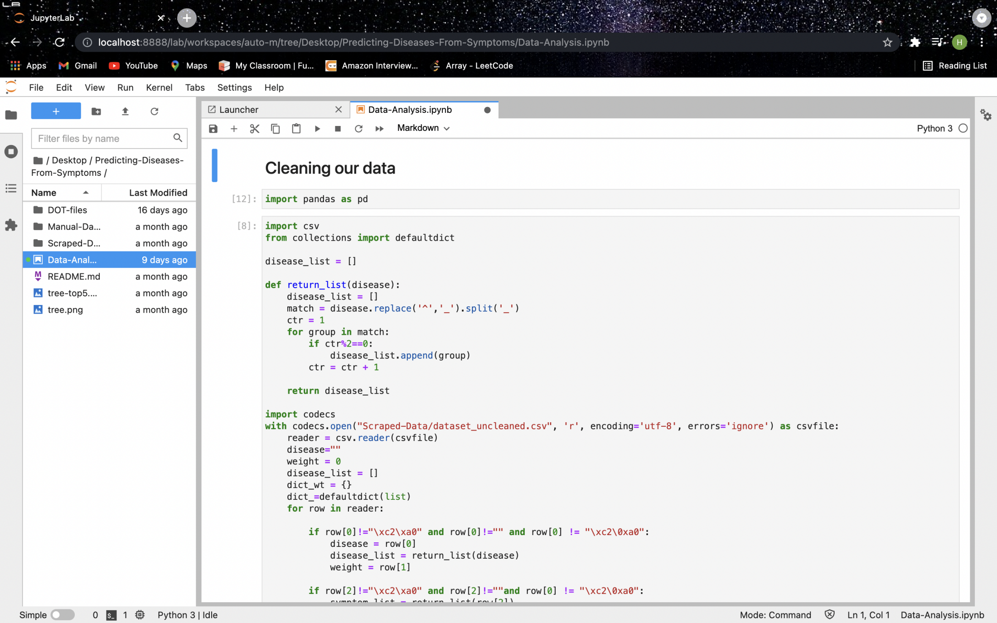
Screenshots of Work till Now. Exploring dataset And Pre-Processing

Slide 18
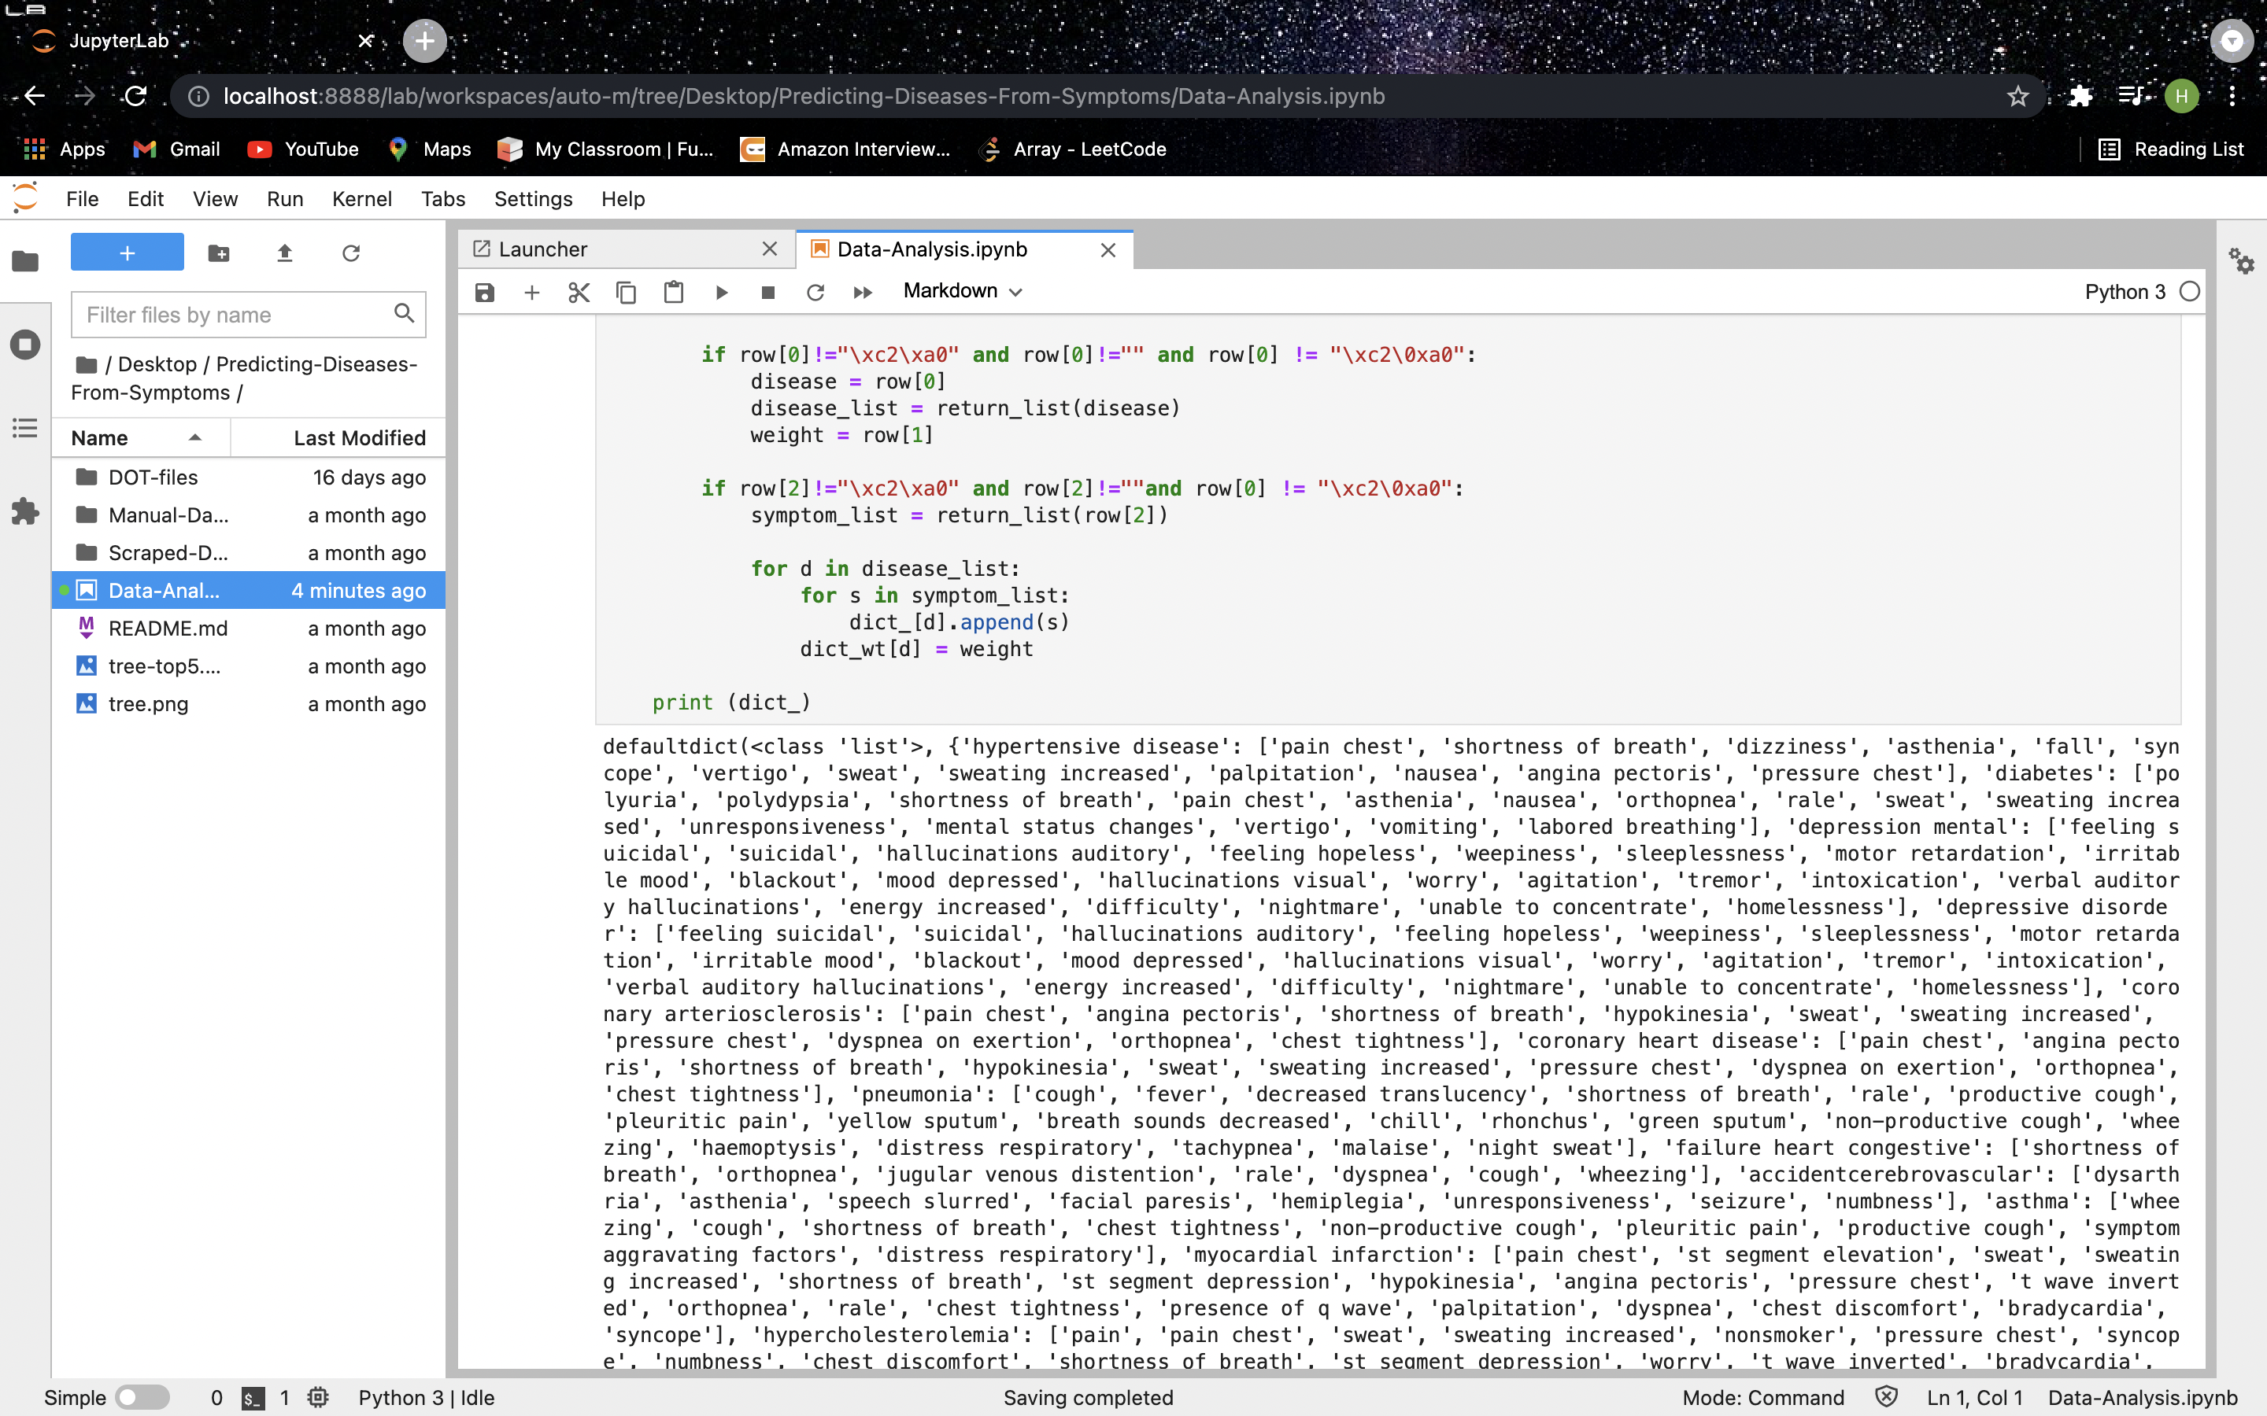
Screenshots of Work till Now Exploring dataset And Pre-Processing

Slide 19
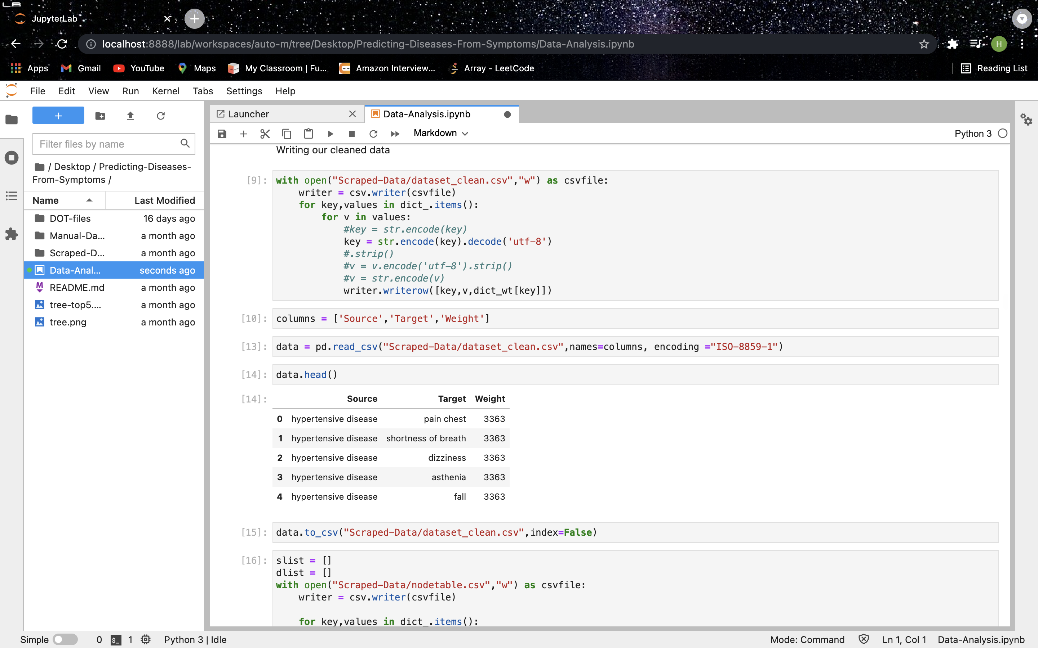
Screenshots of Work till Now Exploring dataset And Pre-Processing

Slide 20
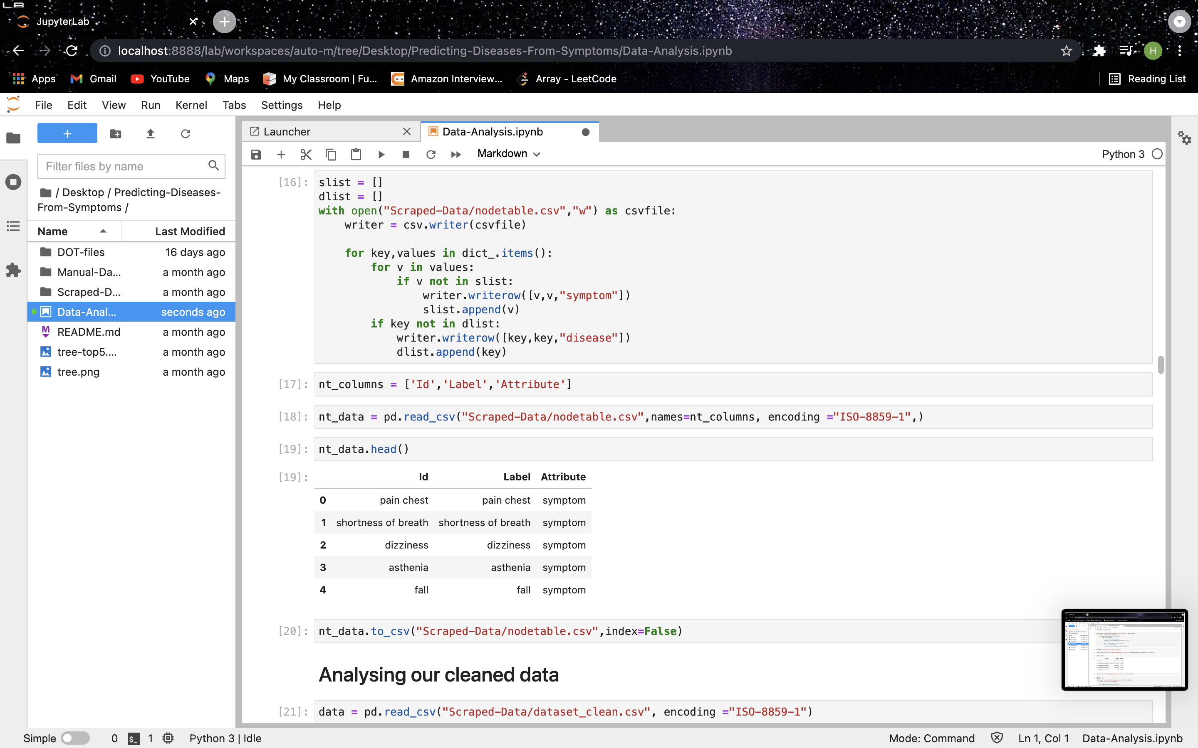
Screenshots of Work till Now Exploring dataset And Pre-Processing

Slide 21
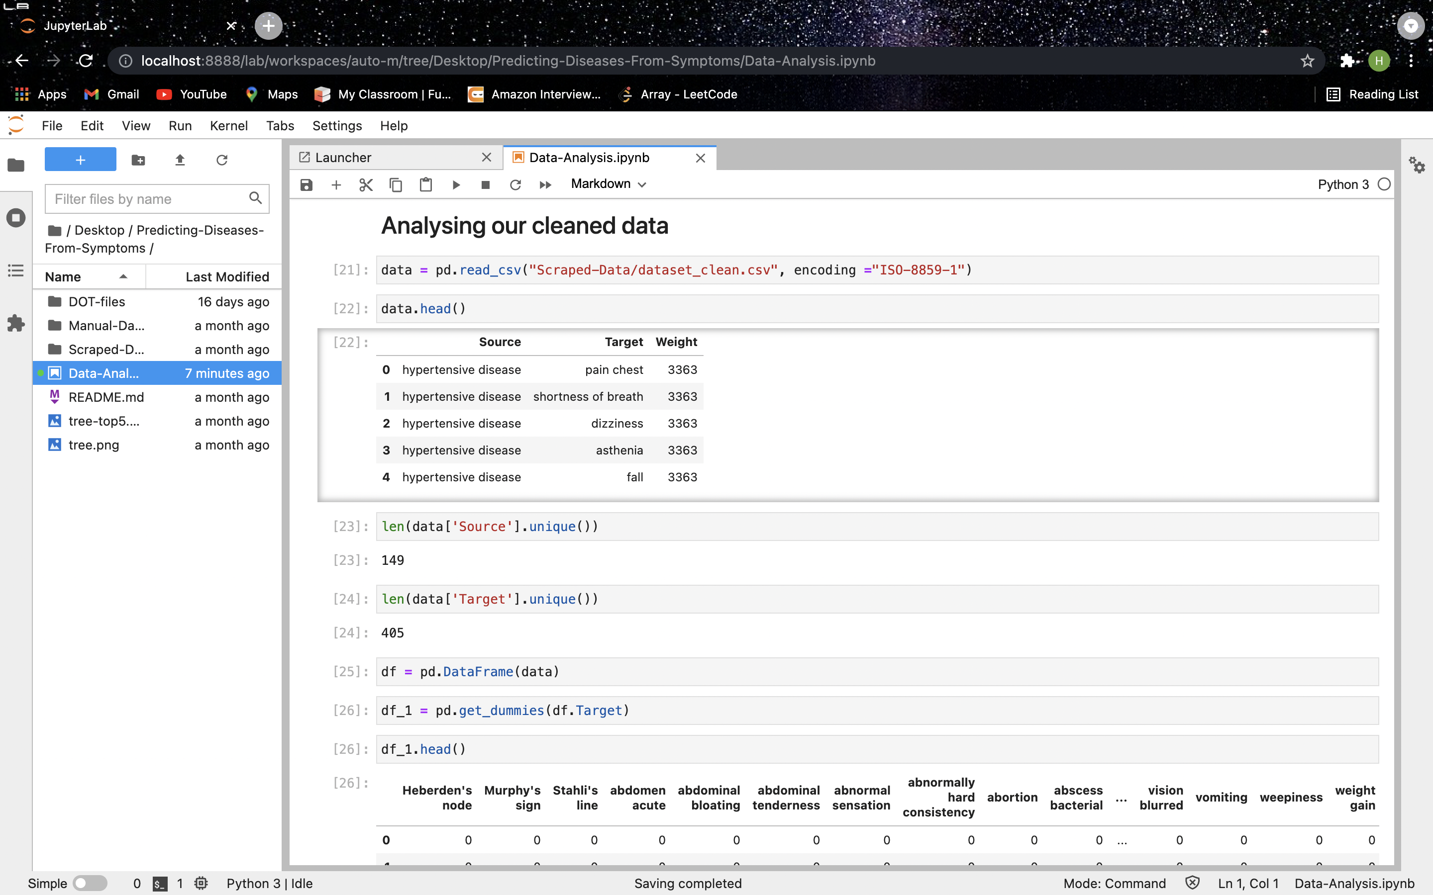
Screenshots of Work till Now Exploring dataset And Pre-Processing

Slide 22
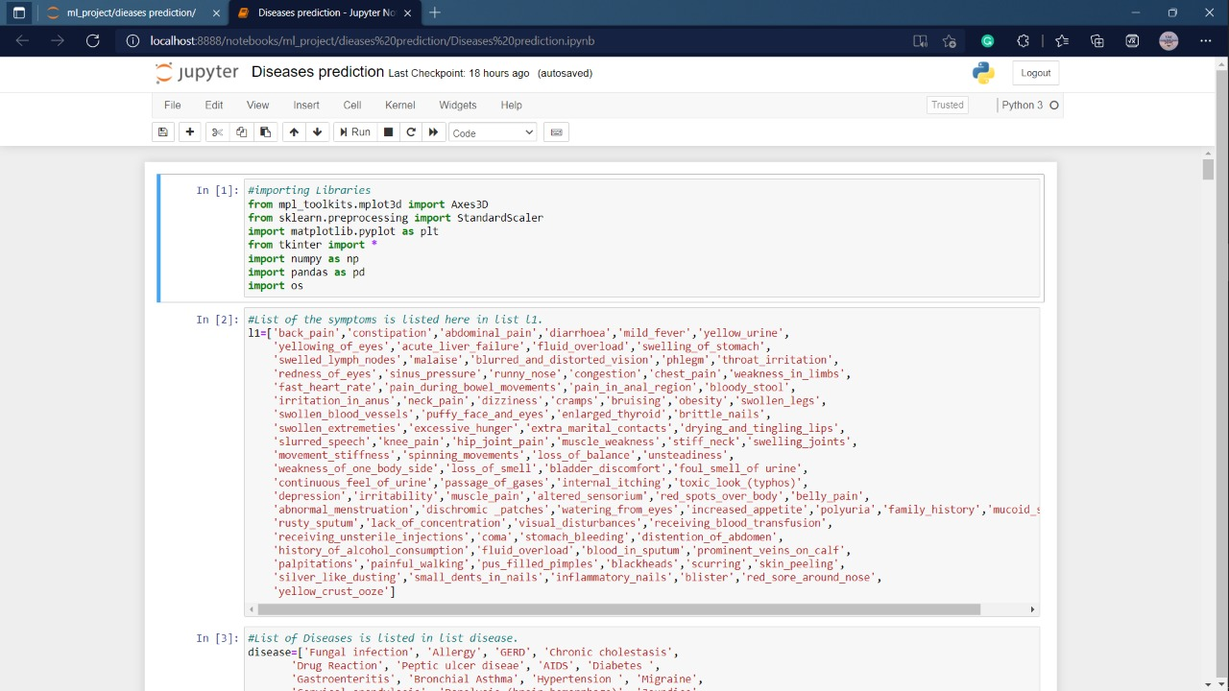
Screenshots of Work till Now

Slide 23
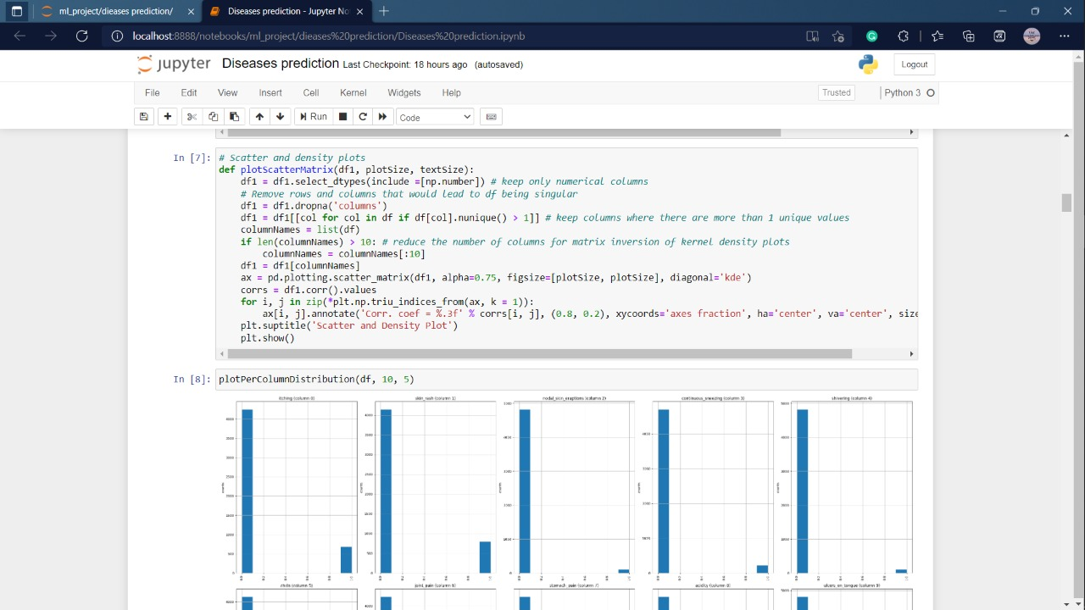
Screenshots of Work till Now

Slide 24
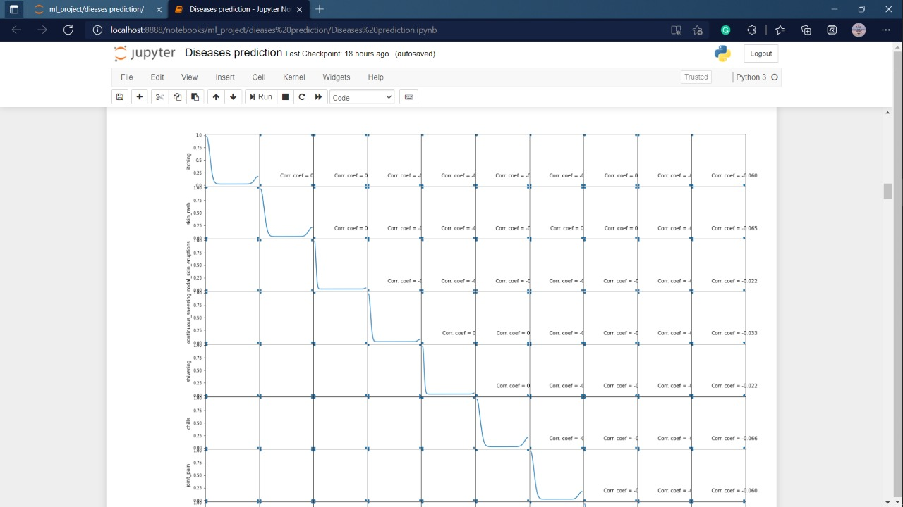
Screenshots of Work till Now

Slide 25
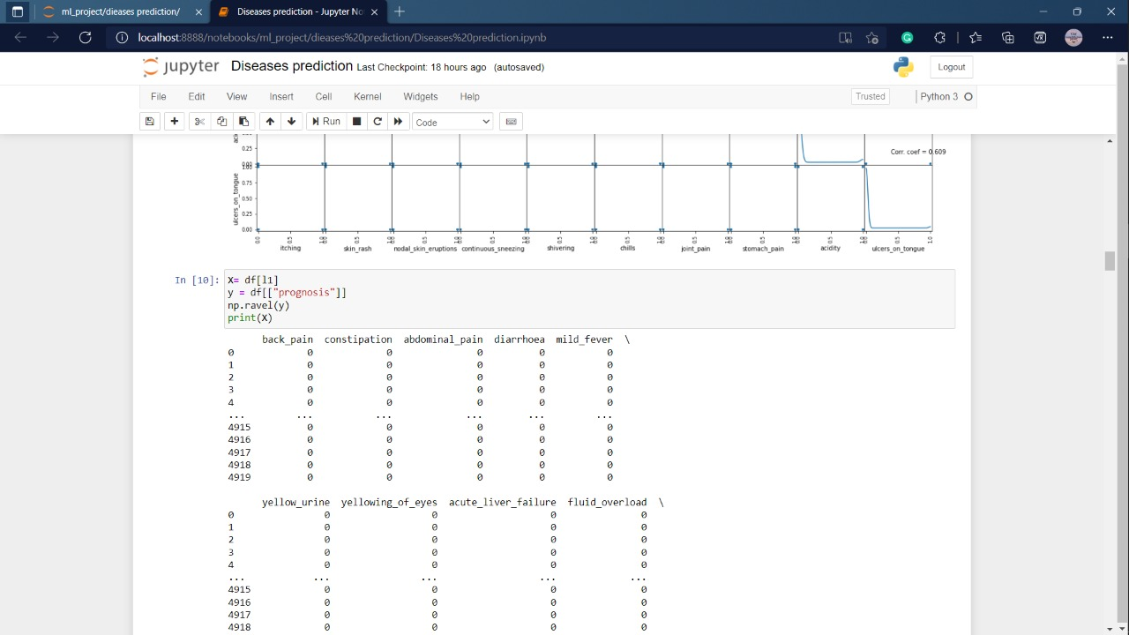
Screenshots of Work till Now

Slide 26
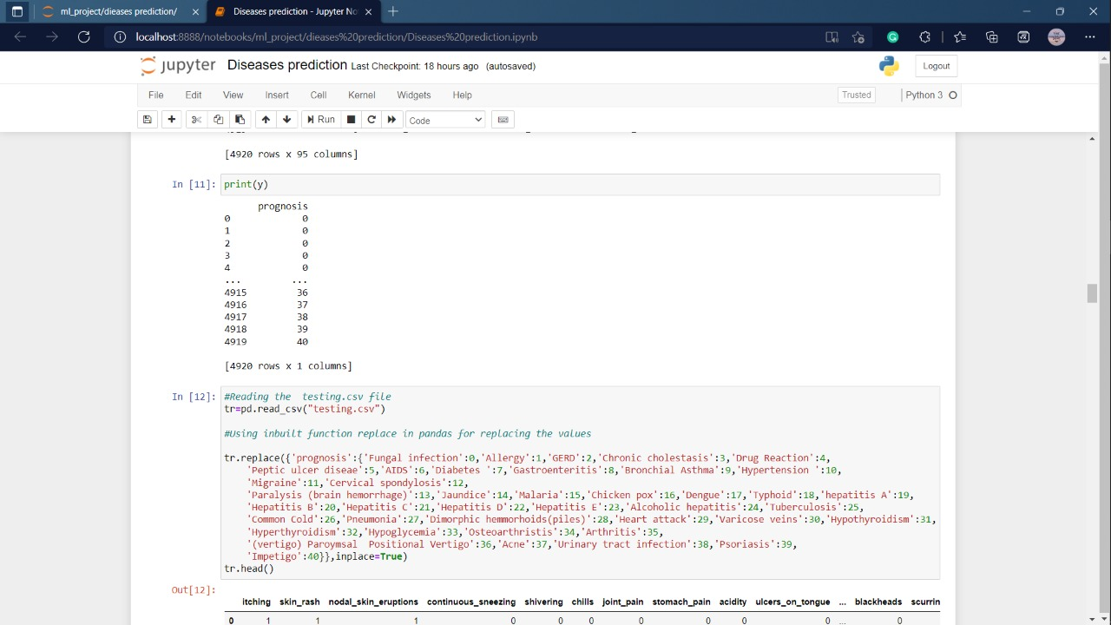
Screenshots of Work till Now

Slide 27
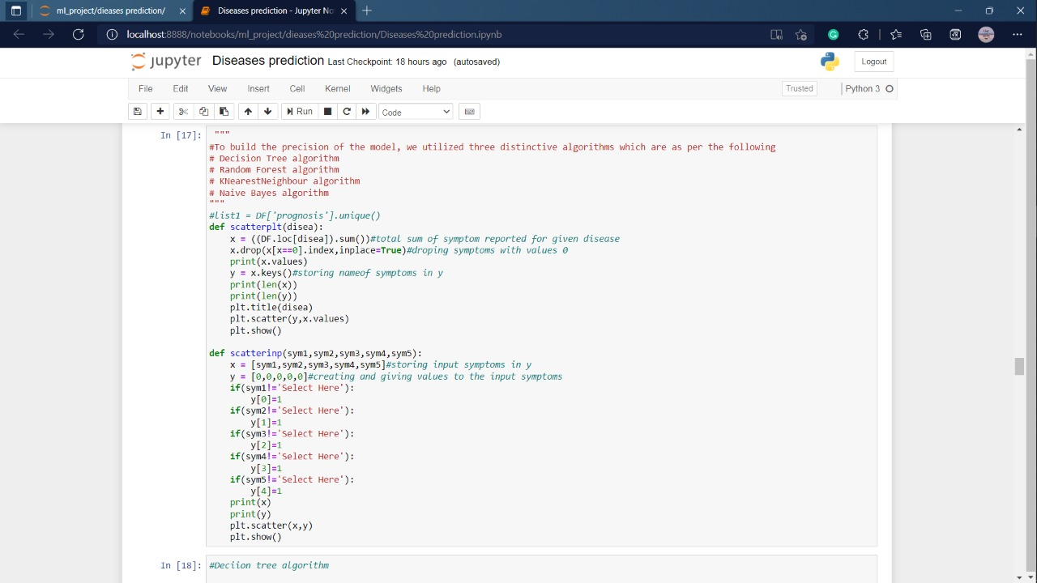
Screenshots of Work till Now

Slide 28
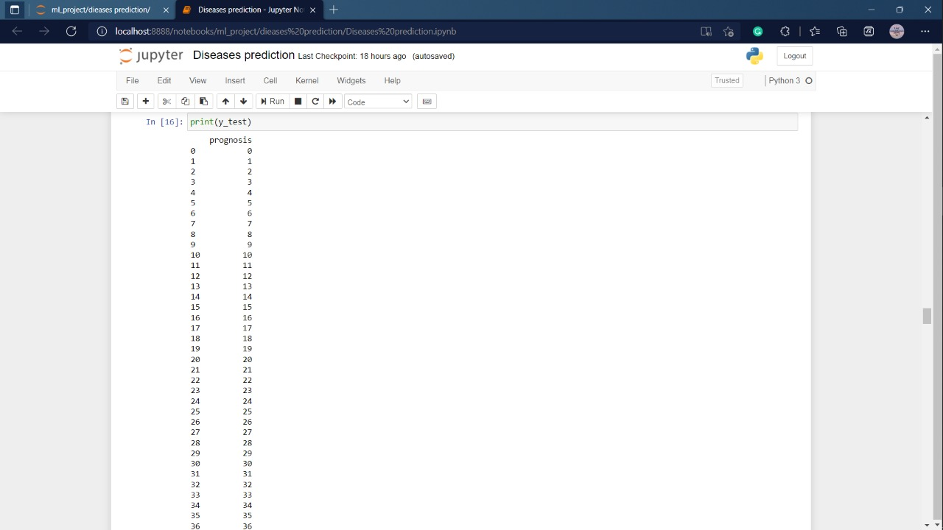
Screenshots of Work till Now

Slide 29
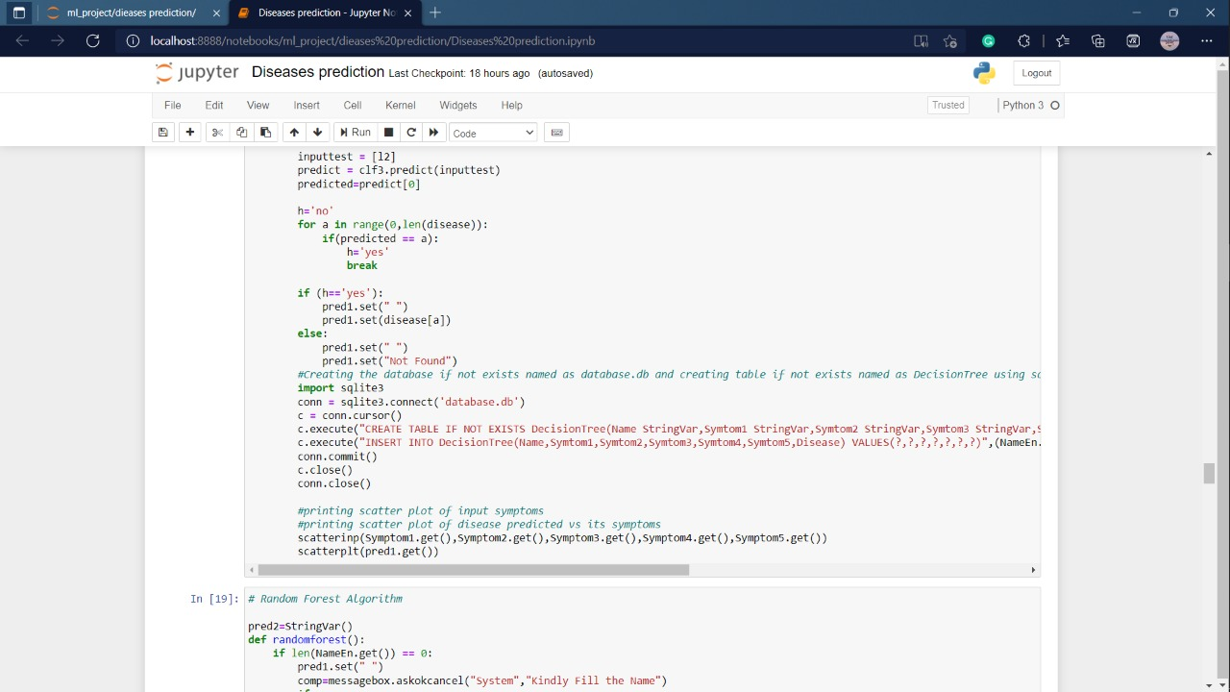
Screenshots of Work till Now

Slide 30
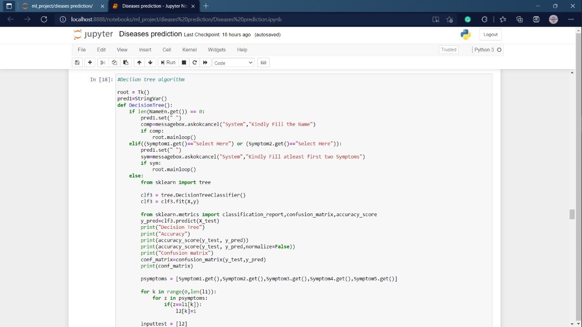
Screenshots of Work till Now

Slide 31
Future Enhancement
The ability to change a user's personal information.
More interactive user interface.
Facilities for creating backups.
It's possible to do this as a Mobile app.
More information about the most recent diseases are available.

Slide 32
Thank You

